Slide 1
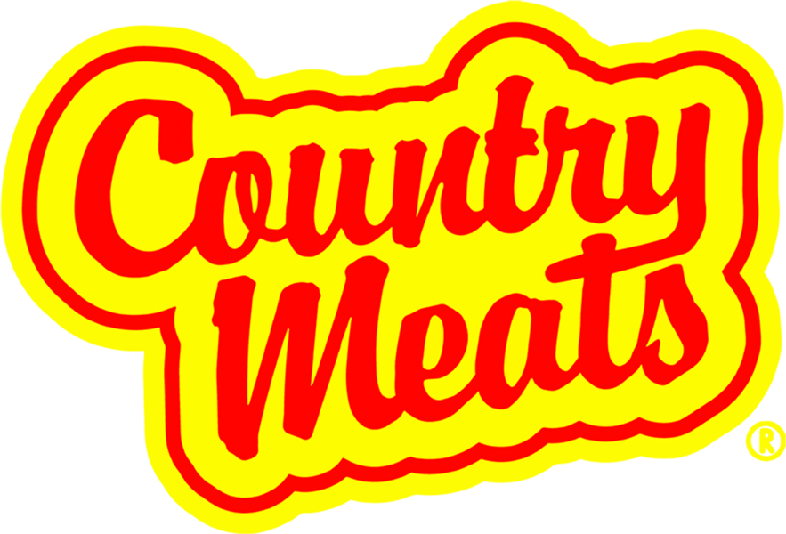
www.countrymeats.com
47 Years of Craftsmanship

Slide 2
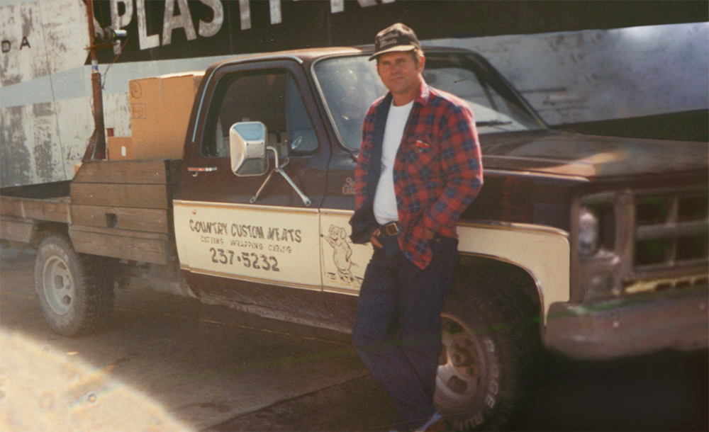
Country Meats
1978 - Jerry Geatches started smoking and curing meats and Country Meats was formed
We started in a retrofitted barn with a dream of helping kids fundraise and a knack for making the tastiest smoked meat sticks around
2010 - We built our 21,000 sq ft facility increasing production capabilities as our business supporting fundraisers grew
2019 Started supporting individual Scout Units all from a simple ad in Boys Life
2024 – Developed a unique multipack packaging format to focus on Council-led Product Sales
2025 – Launched Council Program partnering with eighteen (18) Councils to deliver a Spring Product Sale

Slide 3
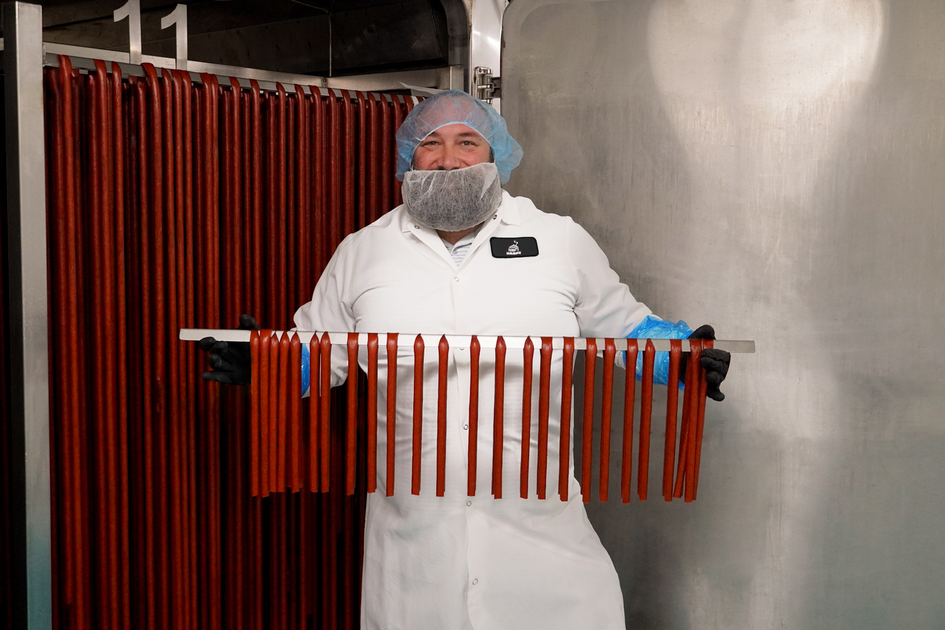





Handcrafted and Made in the USA
85% lean meat with no fillers - Fully cooked for 18 Hours
9g of Protein - 0 trans-fats - 1-3 grams of carbs in every meat stick
SQF Certified and USDA Inspected

Slide 4
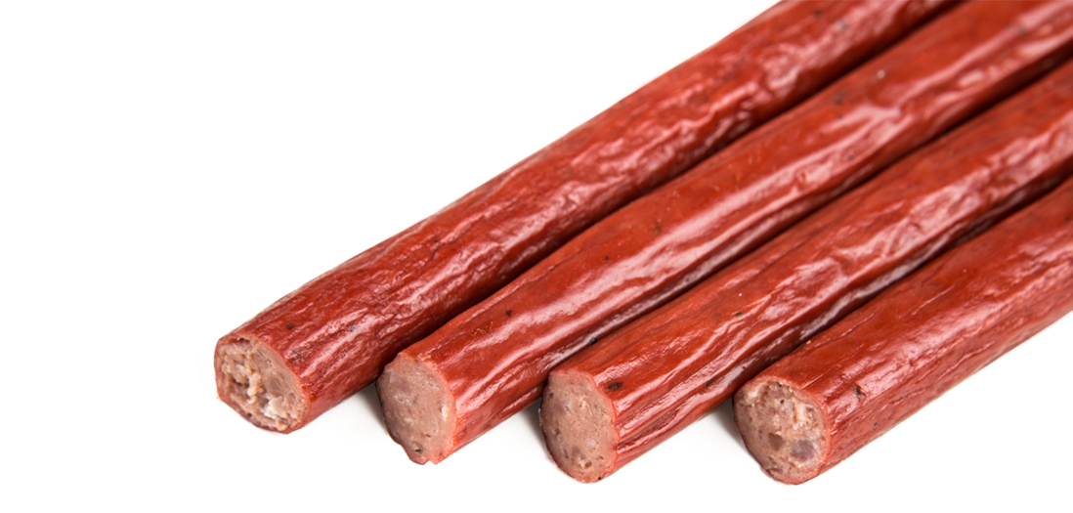
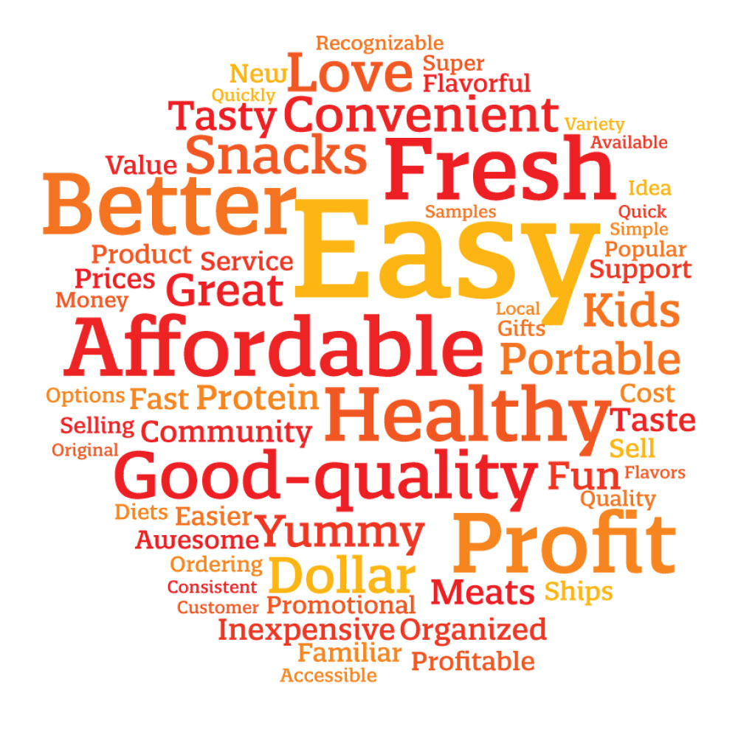
Why Country Meats
Healthy Products – Our products go beyond novelties and empty calories! Every Country Meats stick provides 9 grams of protein with no trans-fats, 1-3 grams of carbs and only 70 calories. These are high quality meat sticks that are an excellent source of protein and energy that you can count on
Quality Products – We understand how important quality and nutrition are to families and parents so we produce products with premium ingredients and craftsmanship that we can feel good about serving to our own children
Convenient & Shelf- Stable - Our perfectly portable meat sticks are individually packaged and carry a one-year shelf-life. Being fully cooked without any need for refrigeration they are easily stored, distributed and transported – all factors that are important to those providing food-assurance services and programs
Crowd-Pleasing Flavors - With over a dozen taste bud-tantalizing flavors our meat sticks make it easy to eat healthier. From sweet to spicey, Country Meats products have broad consumer appeal and customers can't get enough of our Meat Sticks
Proven Performance - Supporting Scouting with over $20 million in fundraising sales over the past 10 years! Multipacks are engineered to support Scout participation and address the need for lower priced fundraising product items driving container sales growth in the Council Product Sale.

Slide 5
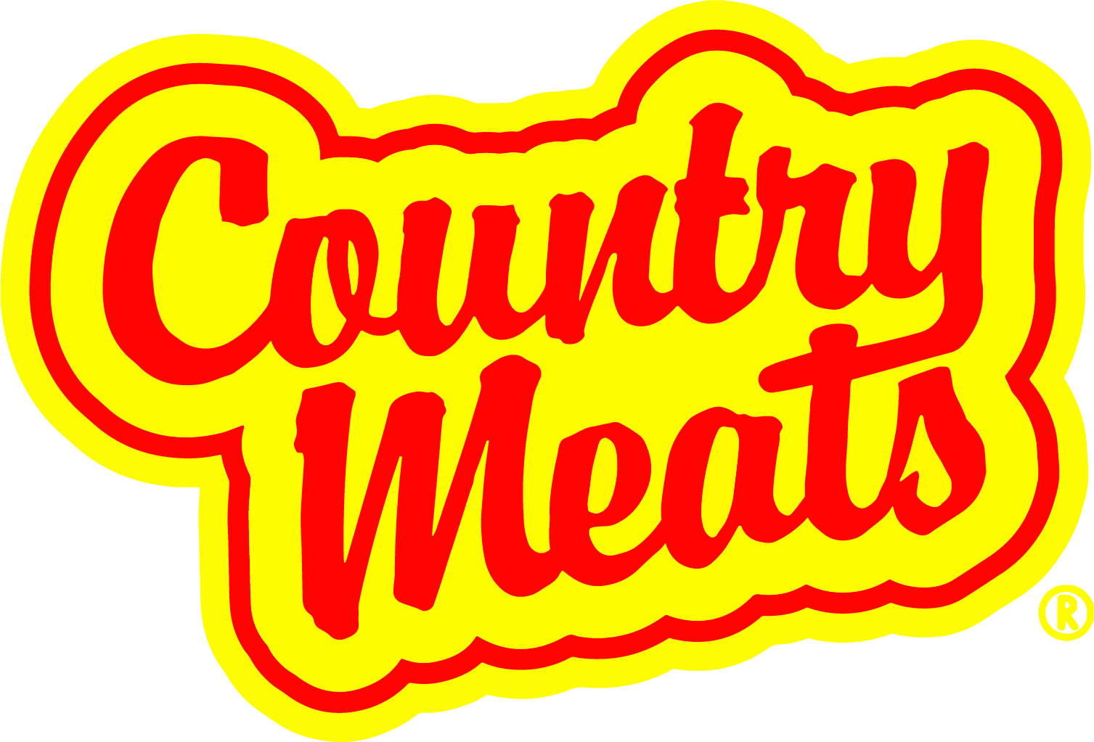
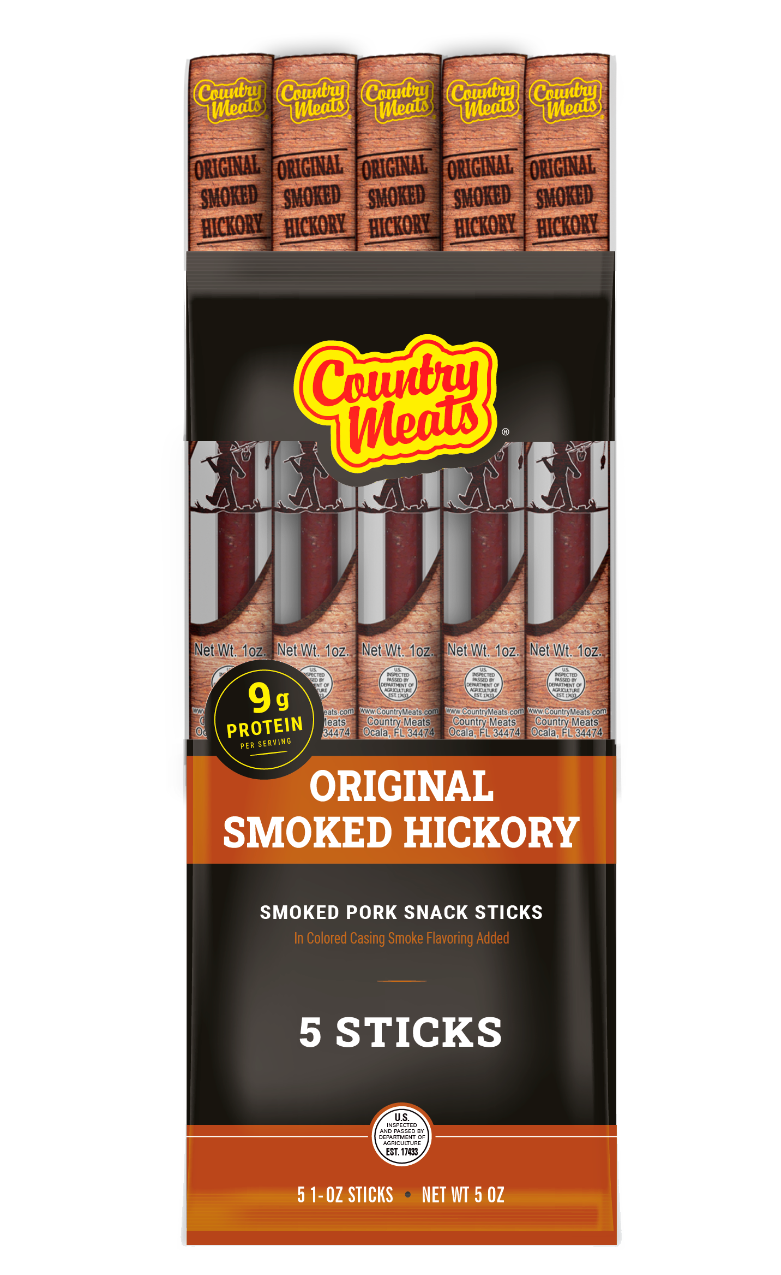
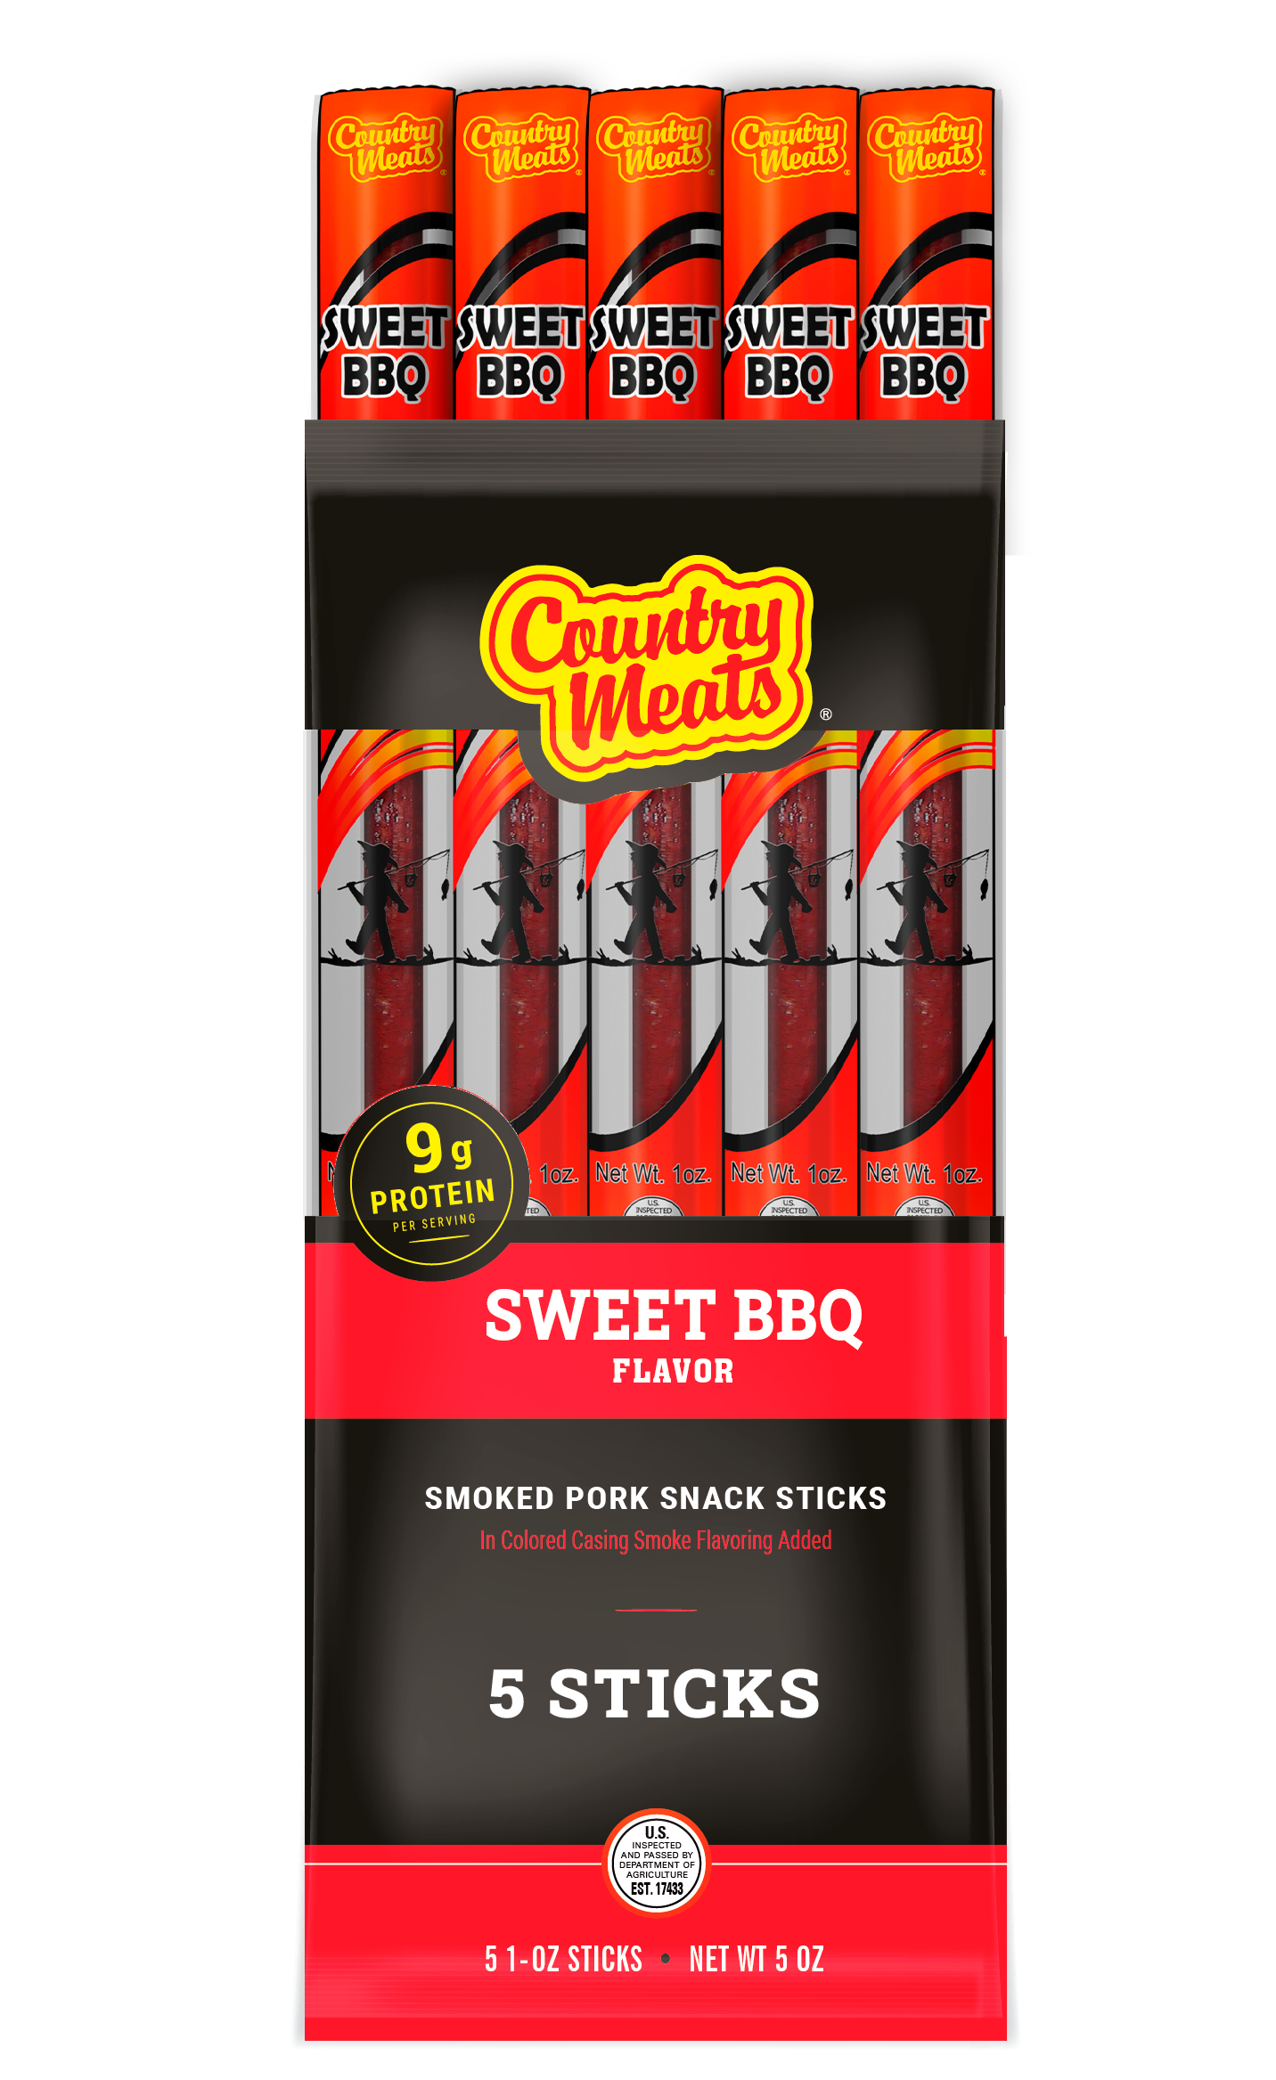
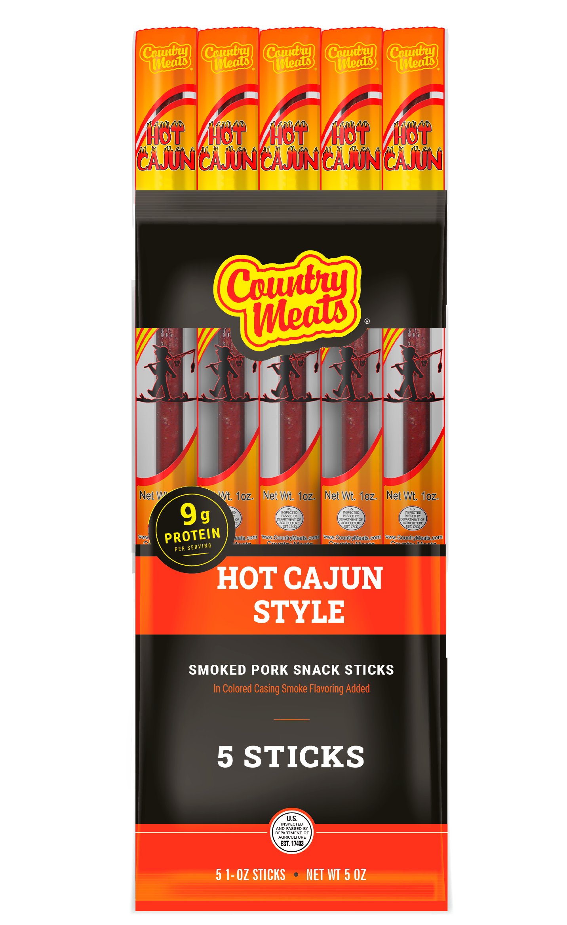
Country Meats
Multipack Products
Now Available!
Supports Scout and Leader participation in the Council Product Sale by offering industry proven fundraising item that Scout Families feel good about selling
Multipack products support container sales growth in the Council Product Sale by offering a complimentary value item
Multipack products present an improved entry level product that tastes great and presents consumers and families with more value and versatility for their support
$10.00 Retail

Slide 6
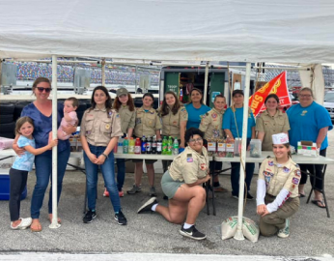
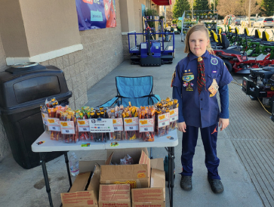
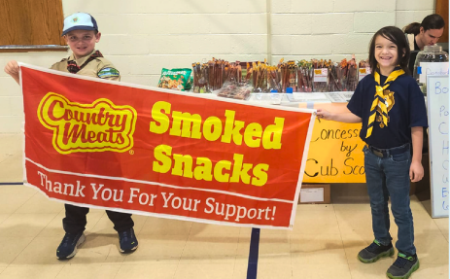
Why Include Multipack Products?
Scouts
Proven fundraisjng item helps get more consumes to say “yes” in support of Scouts adventure and Council Product Sale
Lower priced value item offering gets more Scouts participating in the Council Product Sale and funding their Scouting Adventure
Leaders
Unit Leaders and Scout Families have been asking for a lower priced product item in the Council Product Sale
At $10 retail it easily fits right into Show & Sell and Wagon Sale activities
Supporters
Innovative packaging – Single serve portions
Heathier option to support Scouts - 9 grams of delicious protein in every meat stick
Broad consumer appeal for Country Meats multipack products
Councils
Complimentary fundraising product item with proven sales results
Supporting Scouting with over $20 million in sales over the past 10 years!
A shelf-stable product that provides nutrition and value to Scouting supporters
Country Meats products are Scout/Family-Friendly - Proven, Safe and Trusted
Country Meats Products are utilized at Philmont Scout Ranch and the Northern Tier

Slide 7

Multipack Product Benefits
Country Meats Multipacks were created to help raise more money in less time
Reduces the complexity of Scouts creating bundles or selling sticks individually
Supports increased Product Sale participation
Increases consumer support and Scout sales success
Compliments other Council-led product sales efforts
Creates excitement in the Council Product Sale
Helps Scouts to earn their way!
Top 3 Flavors!
Original, Sweet & Spicy

Slide 8
Simple, Effective, Profitable
$10 Suggested Retail – Terrific price point to attract consumer support
62.5% Scouting Profit - Industry proven fundraising product that consumers enjoy
Simple product configuration to help make Product Sale as effective as possible:
  Ordered at the case level – 40 containers per case ($400 retail value)
  Choose from three available flavors, at the case level:
    Classic -Original Smoked Hickory
    Sweet - Sweet BBQ
    Spicy - Hot Cajun
Unit commission rates are determined by the Council
Council can invoice Unit for the retail value of the product ordered, minus Unit commission
Council assumes financial responsibility of product - Payment terms provided, Net 30
Free Shipping to Council Location
No Minimum orders
Low turn-around time
Note: While this product is part of the overall Council Product Sale, it is conducted outside of any sales apps or standard ordering platforms so you will need to collect the money from your sale via cash or a credit card reader program.

Slide 9
Simple, Effective, Profitable
25 Units Participating
  @ 3 cases per Unit = $30,000
  @ 5 cases per Unit = $50,000
  @ 8 cases per Unit = $80,000
50 Units Participating
  @ 3 cases per Unit = $60,000
  @ 5 cases per Unit = $100,000
  @ 8 cases per Unit = $160,000
100 Units Participating
  @ 3 cases per Unit = $120,000
  @ 5 cases per Unit = $200,000
  @ 8 cases per Unit = $320,000
Complimentary product item
Incremental sales revenue
Container sales growth
Create environment for sustainable Product Sale Growth
Guideline to Unit Ordering:
3 cases per Unit - Recommended Initial Order
5 cases per Unit - Actual Sales Results
8 cases per Unit - Engaged Sales Results

Slide 10
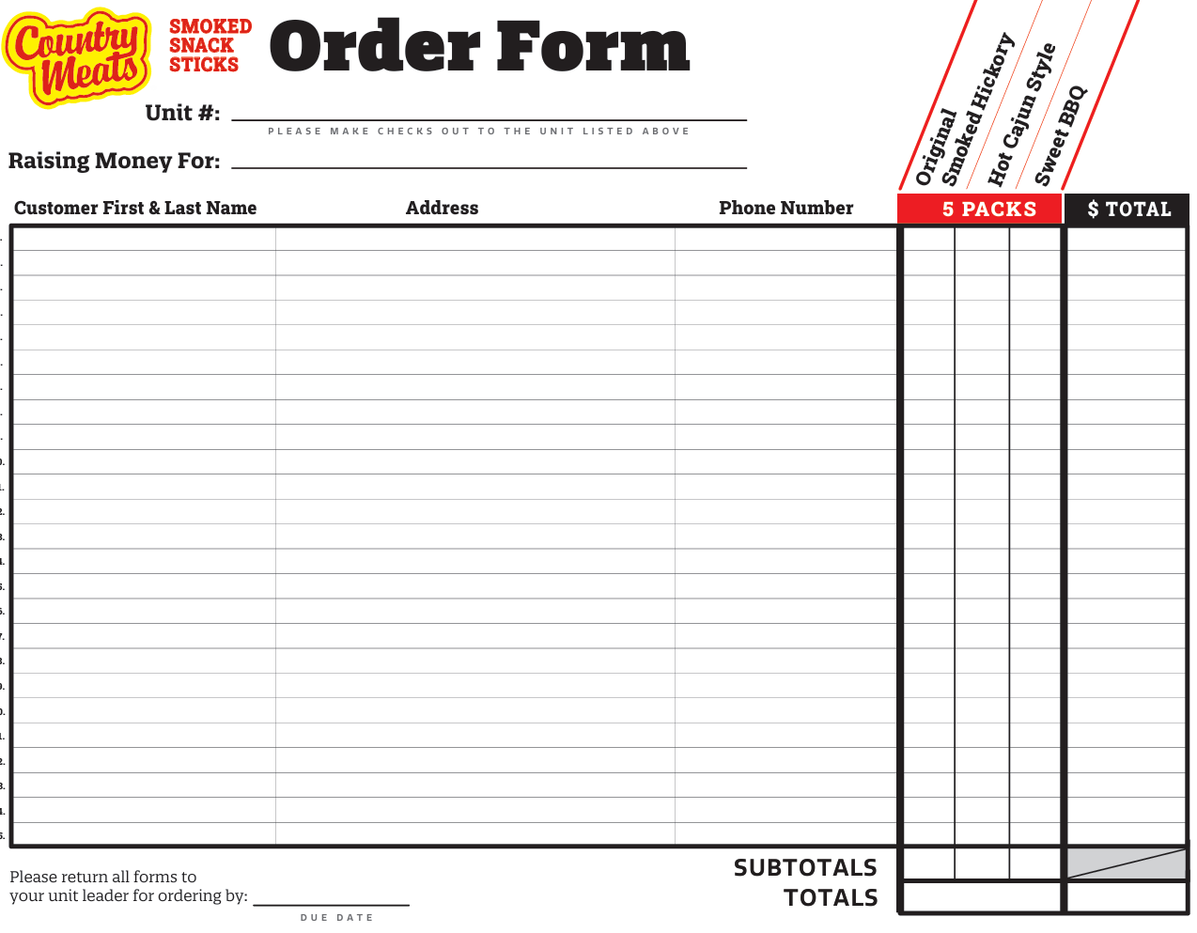
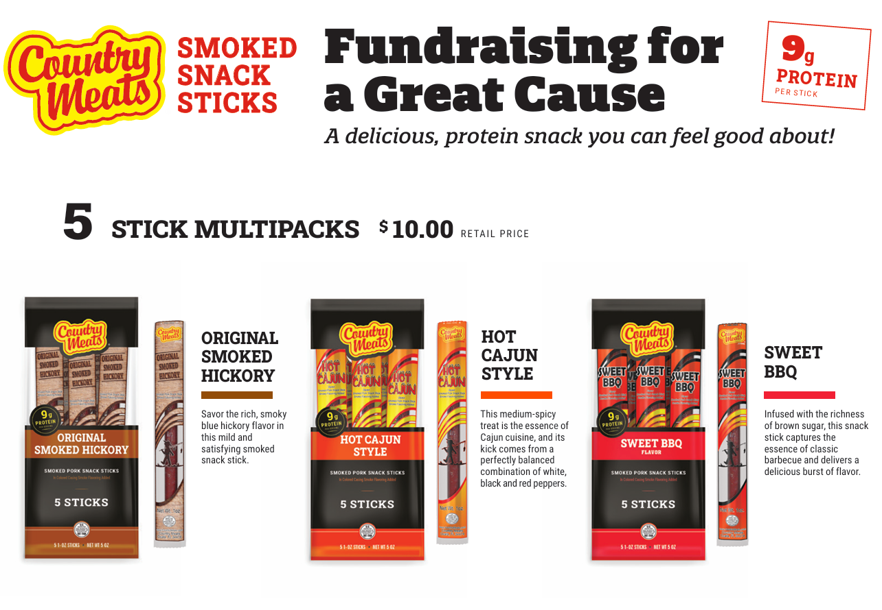
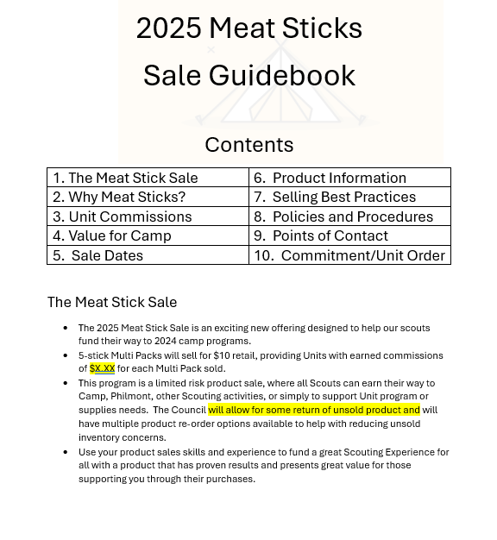
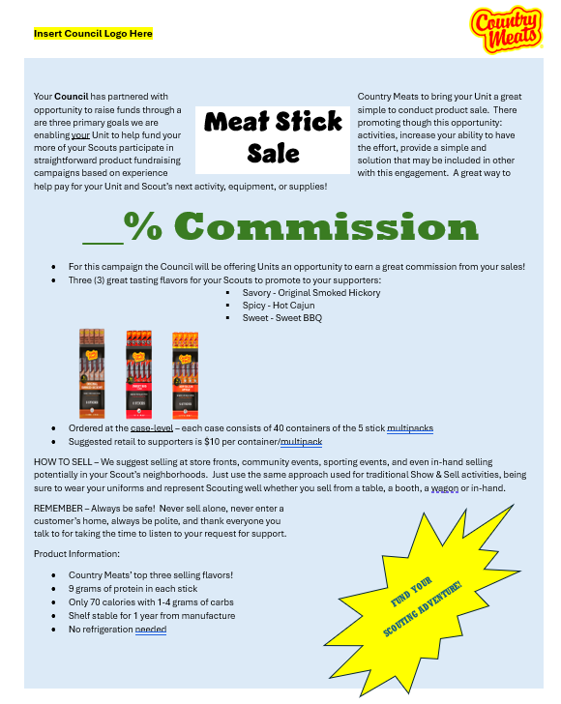
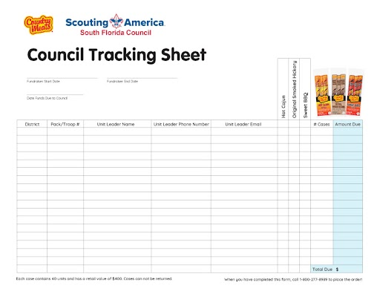
Program Tools
Scout Order Form
Leaders Guidebook (Template)
Meat Stick Flyer
Council Tracking Sheet
Scout Product Check Out Log
Country Meats Banners
Multipack Product Samples
Promotional Incentives

